Slide 1
A Very Fast Method for Clustering Big Text Datasets
Frank Lin and William W. Cohen
School of Computer Science, Carnegie Mellon University
ECAI 2010
2010-08-18, Lisbon, Portugal

Slide 2
Overview
Preview
The Problem with Text Data
Power Iteration Clustering (PIC)
  Spectral Clustering
  The Power Iteration
  Power Iteration Clustering
Path Folding
Results
Related Work

Slide 3
Overview
Preview
The Problem with Text Data
Power Iteration Clustering (PIC)
  Spectral Clustering
  The Power Iteration
  Power Iteration Clustering
Path Folding
Results
Related Work

Slide 4
Preview
Spectral clustering methods are nice
We want to use them for clustering text data
(A lot of)

Slide 5
Preview
However, two obstacles:
1. Spectral clustering computes eigenvectors – in general very slow
2. Spectral clustering uses similarity matrix – too big to store & run
Our solution:
Power iteration clustering with path folding!

Slide 6
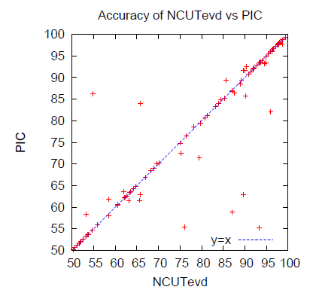
Preview
Diagonal: tied (most datasets)
An accuracy result:
Upper triangle: we win
No statistically significant difference – same accuracy
Each point is accuracy for a 2-cluster text dataset
Lower triangle: spectral clustering wins

Slide 7
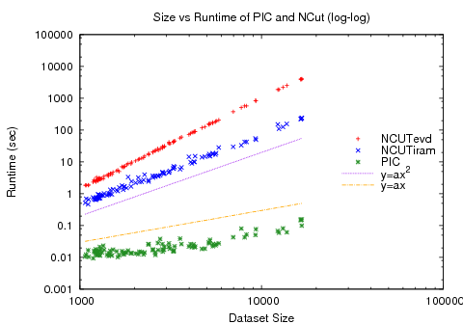
Preview
y: algorithm runtime (log scale)
Spectral clustering (red & blue)
A scalability result:
Quadratic curve
Linear curve
x: data size (log scale)
Our method (green)

Slide 8
Overview
Preview
The Problem with Text Data
Power Iteration Clustering (PIC)
  Spectral Clustering
  The Power Iteration
  Power Iteration Clustering
Path Folding
Results
Related Work

Slide 9
The Problem with Text Data
Documents are often represented as feature vectors of words:
The importance of a Web page is an inherently subjective matter, which depends on the readers…
In this paper, we present Google, a prototype of a large-scale search engine which makes heavy use…
You're not cool just because you have a lot of followers on twitter, get over yourself…
cool | web | search | make | over | you
0 | 4 | 8 | 2 | 5 | 3
0 | 8 | 7 | 4 | 3 | 2
1 | 0 | 0 | 0 | 1 | 2

Slide 10
The Problem with Text Data
Feature vectors are often sparse
But similarity matrix is not!
Mostly non-zero - any two documents are likely to have a word in common
Mostly zeros - any document contains only a small fraction of the vocabulary
 | 27 | 125 | -
 | 23 | - | 125
 | - | 23 | 27
cool | web | search | make | over | you
0 | 4 | 8 | 2 | 5 | 3
0 | 8 | 7 | 4 | 3 | 2
1 | 0 | 0 | 0 | 1 | 2

Slide 11
The Problem with Text Data
In general O(n³); approximation methods still not very fast
A similarity matrix is the input to many clustering methods, including spectral clustering
Spectral clustering requires the computation of the eigenvectors of a similarity matrix of the data
Too expensive! Does not scale up to big datasets!
O(n²) time to construct
 | 27 | 125 | -
 | 23 | - | 125
 | - | 23 | 27
O(n²) space to store
> O(n²) time to operate on

Slide 12
The Problem with Text Data
We want to use the similarity matrix for clustering (like spectral clustering), but:
  Without calculating eigenvectors
  Without constructing or storing the similarity matrix
Power Iteration Clustering
+ Path Folding

Slide 13
Overview
Preview
The Problem with Text Data
Power Iteration Clustering (PIC)
  Spectral Clustering
  The Power Iteration
  Power Iteration Clustering
Path Folding
Results
Related Work

Slide 14
Spectral Clustering
Idea: instead of clustering data points in their original (Euclidean) space, cluster them in the space spanned by the “significant” eigenvectors of a (Laplacian) similarity matrix
A popular spectral clustering method: normalized cuts (NCut)
NCut uses a normalized matrix W=I-D⁻¹A; I is the identity matrix and D is defined D_{ii}=Σ_{j} A_{ij}
An unnormalized similarity matrix A_{ij} is the similarity between data points i and j.

Slide 15
Spectral Clustering
dataset and normalized cut results
cluster
1
2
3
clustering space
2nd smallest eigenvector
value
index
3rd smallest eigenvector

Slide 16
Spectral Clustering
A typical spectral clustering algorithm:
  Choose k and similarity function s
  Derive affinity matrix A from s, transform A to a (normalized) Laplacian matrix W
  Find eigenvectors and corresponding eigenvalues of W
  Pick the k eigenvectors of W with the smallest corresponding eigenvalues as “significant” eigenvectors
  Project the data points onto the space spanned by these vectors
  Run k-means on the projected data points

Slide 17
Spectral Clustering
Normalized Cut algorithm (Shi & Malik 2000):
  Choose k and similarity function s
  Derive A from s, let W=I-D⁻¹A, where I is the identity matrix and D is a diagonal square matrix D_{ii}=Σ_{j} A_{ij}
  Find eigenvectors and corresponding eigenvalues of W
  Pick the k eigenvectors of W with the 2nd to k^{th} smallest corresponding eigenvalues as “significant” eigenvectors
  Project the data points onto the space spanned by these vectors
  Run k-means on the projected data points
Finding eigenvectors and eigenvalues of a matrix is very slow in general: O(n³)
Can we find a similar low-dimensional embedding for clustering without eigenvectors?

Slide 18
Overview
Preview
The Problem with Text Data
Power Iteration Clustering (PIC)
  Spectral Clustering
  The Power Iteration
  Power Iteration Clustering
Path Folding
Results
Related Work

Slide 19
The Power Iteration
Or the power method, is a simple iterative method for finding the dominant eigenvector of a matrix:
Typically converges quickly; fairly efficient if W is a sparse matrix
v^{t} : the vector at iteration t;
v⁰ typically a random vector
c : a normalizing constant to keep v^{t} from getting too large or too small
W : a square matrix

Slide 20
The Power Iteration
Or the power method, is a simple iterative method for finding the dominant eigenvector of a matrix:
What if we let W=D⁻¹A (similar to Normalized Cut)?

Slide 21
The Power Iteration
It turns out that, if there is some underlying cluster in the data, PI will quickly converge locally within clusters then slowly converge globally to a constant vector.
The locally converged vector, which is a linear combination of the top eigenvectors, will be nearly piece-wise constant with each piece corresponding to a cluster

Slide 22
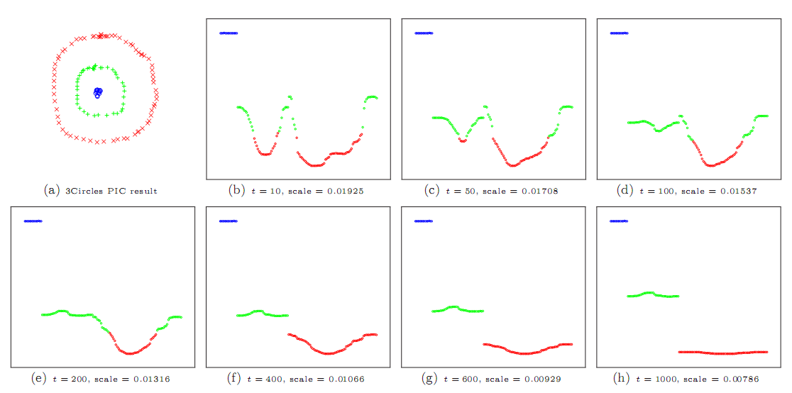
The Power Iteration
colors correspond to what k-means would “think” to be clusters in this one-dimension embedding
larger
smaller

Slide 23
Overview
Preview
The Problem with Text Data
Power Iteration Clustering (PIC)
  Spectral Clustering
  The Power Iteration
  Power Iteration Clustering
Path Folding
Results
Related Work

Slide 24
Power Iteration Clustering
The 2nd to k^{th} eigenvectors of W=D⁻¹A are roughly piece-wise constant with respect to the underlying clusters, each separating a cluster from the rest of the data (Meila & Shi 2001)
The linear combination of piece-wise constant vectors is also piece-wise constant!

Slide 25
Spectral Clustering
dataset and normalized cut results
cluster
1
2
3
clustering space
2nd smallest eigenvector
value
index
3rd smallest eigenvector

Slide 26
a·
+
b·
=

Slide 27
Power Iteration Clustering
dataset and PIC results
Key idea: to do clustering, we may not need all the information in a spectral embedding (e.g., distance between clusters in a k-dimension eigenspace)
v^{t}
we just need the clusters to be separated in some space.

Slide 28
Power Iteration Clustering
Okay, we have a fast clustering method – but there’s the W that requires O(n²) storage space and construction and operation time!
A basic power iteration clustering (PIC) algorithm:
Input: A row-normalized affinity matrix W and the number of clusters k
Output: Clusters C₁, C₂, …, C_{k}
Pick an initial vector v⁰
Repeat
  Set v^{t+1} ← Wv^{t}
  Set δ^{t+1} ← |v^{t+1} – v^{t}|
  Increment t
  Stop when |δ^{t} – δ^{t-1}| ≈ 0
Use k-means to cluster points on v^{t} and return clusters C₁, C₂, …, C_{k}
For more details on power iteration clustering, like how to stop, please refer to Lin & Cohen 2010 (ICML)

Slide 29
Overview
Preview
The Problem with Text Data
Power Iteration Clustering (PIC)
  Spectral Clustering
  The Power Iteration
  Power Iteration Clustering
Path Folding
Results
Related Work

Slide 30
Path Folding
Okay, we have a fast clustering method – but there’s the W that requires O(n²) storage space and construction and operation time!
A basic power iteration clustering (PIC) algorithm:
Input: A row-normalized affinity matrix W and the number of clusters k
Output: Clusters C₁, C₂, …, C_{k}
Pick an initial vector v⁰
Repeat
  Set v^{t+1} ← Wv^{t}
  Set δ^{t+1} ← |v^{t+1} – v^{t}|
  Increment t
  Stop when |δ^{t} – δ^{t-1}| ≈ 0
Use k-means to cluster points on v^{t} and return clusters C₁, C₂, …, C_{k}
Key operation in PIC
Note: matrix-vector multiplication!

Slide 31
Path Folding
Well, not if this matrix is dense…
And these are sparse!
What’s so good about matrix-vector multiplication?
If we can decompose the matrix…
Then we arrive at the same solution doing a series of matrix-vector multiplications!
Wait! Isn’t this more time-consuming then before? What’s the point?

Slide 32
Path Folding
As long as we can decompose the matrix into a series of sparse matrices, we can turn a dense matrix-vector multiplication into a series of sparse matrix-vector multiplications.
This is exactly the case for text data
This means that we can turn an operation that requires O(n²) storage and runtime into one that requires O(n) storage and runtime!
And most other kinds of data as well!

Slide 33
Path Folding
But how does this help us? Don’t we still need to construct the matrix and then decompose it?
No – for many similarity functions, the decomposition can be obtained for at almost no cost.

Slide 34
Path Folding
Example – inner product similarity:
Construction: let d=FF^{T}1 and let D(i,i)=d(i); O(n)
Diagonal matrix that normalizes W so rows sum to 1
The original feature matrix
The feature matrix transposed
Storage: n
Construction: given
Storage: O(n)
Construction: given
Storage: just use F

Slide 35
Path Folding
Okay…how about a similarity function we actually use for text data?
Example – inner product similarity:
Construction: O(n)
Storage:
O(n)
Operation: O(n)
Iteration update:

Slide 36
Path Folding
Diagonal cosine normalizing matrix
Example – cosine similarity:
Construction: O(n)
Storage:
O(n)
Operation: O(n)
Iteration update:
Compact storage: we don’t need a cosine-normalized version of the feature vectors

Slide 37
Path Folding
We refer to this technique as path folding due to its connections to “folding” a bipartite graph into a unipartite graph.
More details on bipartite graph in the paper ☺

Slide 38
Overview
Preview
The Problem with Text Data
Power Iteration Clustering (PIC)
  Spectral Clustering
  The Power Iteration
  Power Iteration Clustering
Path Folding
Results
Related Work

Slide 39
Results
100 datasets, each a combination of documents from 2 categories from Reuters (RCV1) text collection, chosen at random
This way we have 100 2-cluster datasets of varying size and difficulty
Compared proposed method (PIC) to:
  k-means
  Normalized Cut using eigendecomposition (NCUTevd)
  Normalized Cut using fast approximation (NCUTiram)

Slide 40
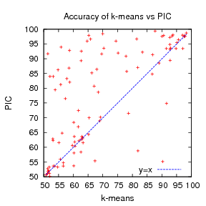
Results
Upper triangle: PIC wins
Each point represents the accuracy result from a dataset
Lower triangle: k-means wins

Slide 41
Results
Upper triangle: PIC wins
Each point represents the accuracy result from a dataset
Lower triangle: k-means wins

Slide 42
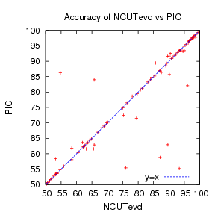
Results
Two methods have almost the same behavior
Overall, one method not statistically significantly better than the other

Slide 43
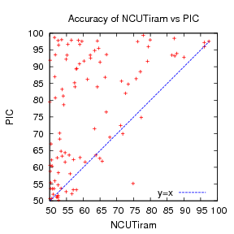
Results
Lesson: Approximate eigen- computation methods may require expertise to work well
Not sure why NCUTiram did not work as well as NCUTevd

Slide 44
Results
y: algorithm runtime (log scale)
How fast do they run?
NCUTevd (red)
NCUTiram (blue)
Quadratic curve
Linear curve
x: data size (log scale)
PIC (green)

Slide 45
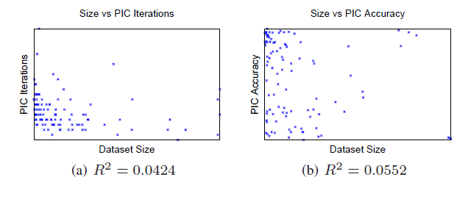
Results
PIC is O(n) per iteration and the runtime curve looks linear…
But I don’t like eyeballing curves, and perhaps the number of iteration increases with size or difficulty of the dataset?
Correlation plot
Correlation statistic
(0=none, 1=correlated)

Slide 46
Overview
Preview
The Problem with Text Data
Power Iteration Clustering (PIC)
  Spectral Clustering
  The Power Iteration
  Power Iteration Clustering
Path Folding
Results
Related Work

Slide 47
Related Work
Not O(n) time methods
Faster spectral clustering
  Approximate eigendecomposition (Lanczos, IRAM)
  Sampled eigendecomposition (Nyström)
Sparser matrix
  Sparse construction
    k-nearest-neighbor graph
    k-matching
  graph sampling / reduction
Still require O(n²) construction in general
Not O(n) space methods

Slide 48
Conclusion
PIC + path folding: a fast, space-efficient, scalable method for clustering text data, using the power of a full pair-wise similarity matrix
Does not “engineer” the input; no sampling or sparsification needed!
Scales well for most other kinds of data too –as long as the number of features are much less than number of data points!

Slide 49
Perguntas?

Slide 50
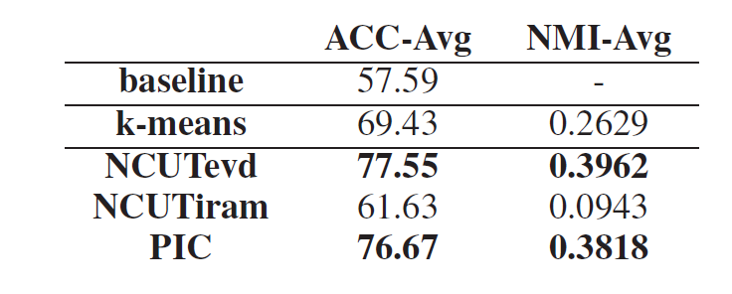
Results

Slide 51
Results
Linear run-time implies constant number of iterations.
Number of iterations to “acceleration-convergence” is hard to analyze:
  Faster than a single complete run of power iteration to convergence.
  On our datasets
    10-20 iterations is typical
    30-35 is exceptional

Slide 52
Related Clustering Work
Spectral Clustering
  (Roxborough & Sen 1997, Shi & Malik 2000, Meila & Shi 2001, Ng et al. 2002)
Kernel k-Means (Dhillon et al. 2007)
Modularity Clustering (Newman 2006)
Matrix Powering
  Markovian relaxation & the information bottleneck method (Tishby & Slonim 2000)
  matrix powering (Zhou & Woodruff 2004)
  diffusion maps (Lafon & Lee 2006)
  Gaussian blurring mean-shift (Carreira-Perpinan 2006)
Mean-Shift Clustering
  mean-shift (Fukunaga & Hostetler 1975, Cheng 1995, Comaniciu & Meer 2002)
  Gaussian blurring mean-shift (Carreira-Perpinan 2006)

Slide 53
Some “Powering” Methods at a Glance
Method | W | Iterate | Stopping | Final
Tishby & Slonim 2000 | W=D⁻¹A | W^{t+1}=W^{t} | rate of information loss | information bottleneck method
Zhou & Woodruff 2004 | W=A | W^{t+1}=W^{t} | a small t | a threshold ε
Carreira-Perpinan 2006 | W=D⁻¹A | X^{t+1}=WX | entropy | a threshold ε
PIC | W=D⁻¹A | v^{t+1}=Wv^{t} | acceleration | k-means
How far can we go with a one- or low-dimensional embedding?

